Slide 1

EDA on Rankings in All three Formats of Cricket(T20,ODI,Test)
Presented by:
Vamshi Krishna Naik
K Vijith Sai
Patwari Raghottam

Slide 2
Objective of the Project
The aim of the Project is to analyze the Rankings and Ratings of Players in all three formats of cricket
( T20,ODI and Test) in the year 2024.This helps us to predict the performance of the players based on rating.
Also to know which country players are more involved in all three formats of cricket rankings.

Slide 3
Languages and Libraries used in Exploratory Data Analysis(EDA)
Programming Language:
Python
Libraries:
1.Regex
2.BeautifulSoup
3.Numpy
4.Pandas
5.Matplotlib & Seaborn

Slide 4
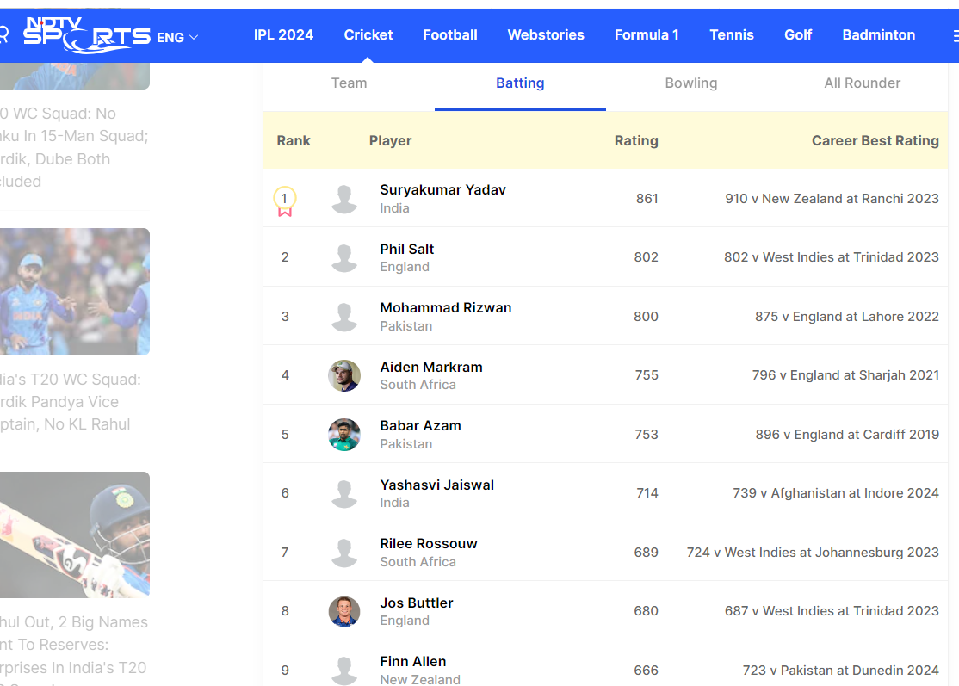
Website
Website used for scrapping:
URL: httpsports.ndtv.com/cricket/icc-rankings

Slide 5
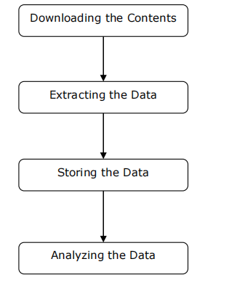
Working of Web Scrapper

Slide 6
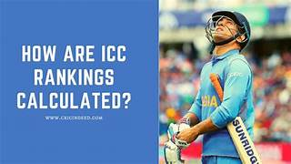
Summary of Data
This rating is worked out by dividing the points scored by the match/series total, with the answer given to the nearest whole number.
It can be compared with a batting average, but with points instead of total runs scored and a match/series total instead of number of times dismissed.

Slide 7
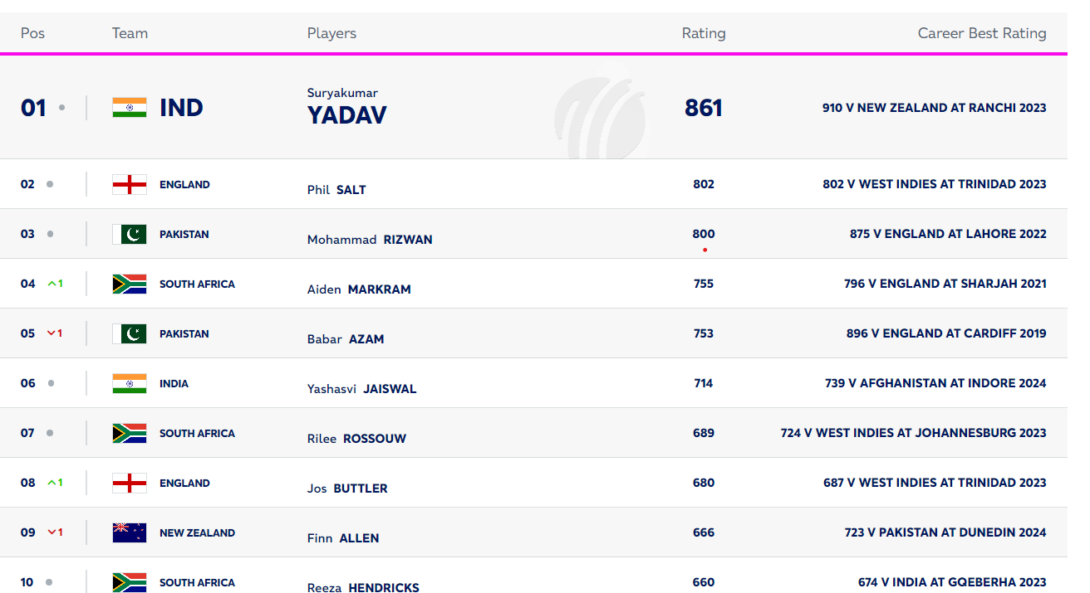
ICC T20 TOP 10 Rankings.

Slide 8
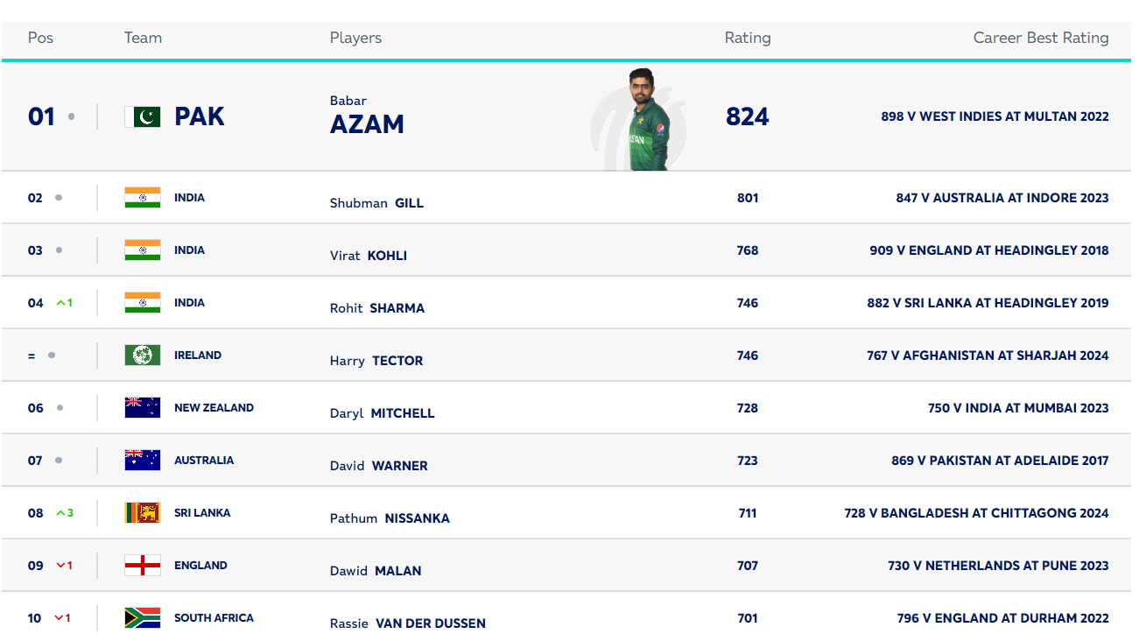
ICC ODI TOP 10 Rankings

Slide 9
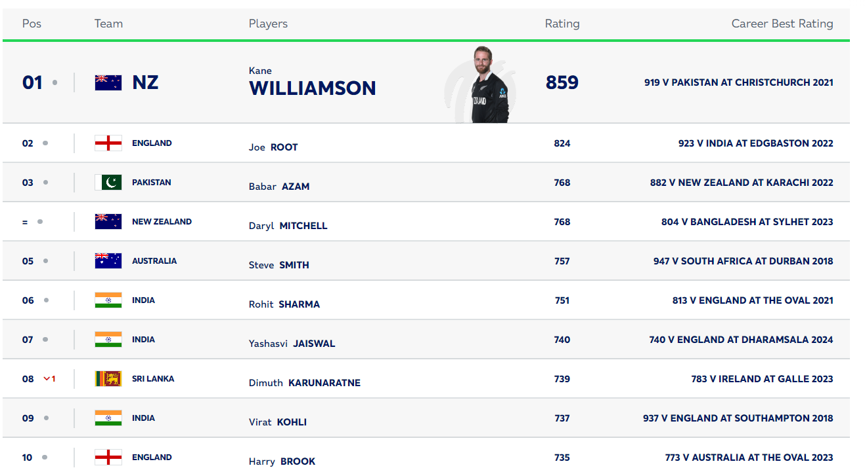
ICC Test TOP 10 Rankings

Slide 10
Summary of Data
Data Frame | Shape | Columns
df(T20_Bat_Rankings) | (100,8) | [“Rank”,”Player”,”Style”,”Team”,”Rating”,”CareerBestRating”, ”Opposition”,”Year”]
df1(ODI_Bat_Rankings) | (100,8) | [“Rank”,”Player”,”Style”,”Team”,”Rating”,”CareerBestRating”, ”Opposition”,”Year”]
df2(Test_Bat_Rankings) | (100,8) | [“Rank”,”Player”,”Style”,”Team”,”Rating”,”CareerBestRating”, ”Opposition”,”Year”]
df(3T20_Bowl_Rankings) | (100,8) | [“Rank”,”Player”,”Style”,”Team”,”Rating”,”CareerBestRating”, ”Opposition”,”Year”]
df4(ODI_Bowl_Rankings) | (100,8) | [“Rank”,”Player”,”Style”,”Team”,”Rating”,”CareerBestRating”, ”Opposition”,”Year”]
df5(Test_Bowl_Rankings) | (100,8) | [“Rank”,”Player”,”Style”,”Team”,”Rating”,”CareerBestRating”, ”Opposition”,”Year”]

Slide 11
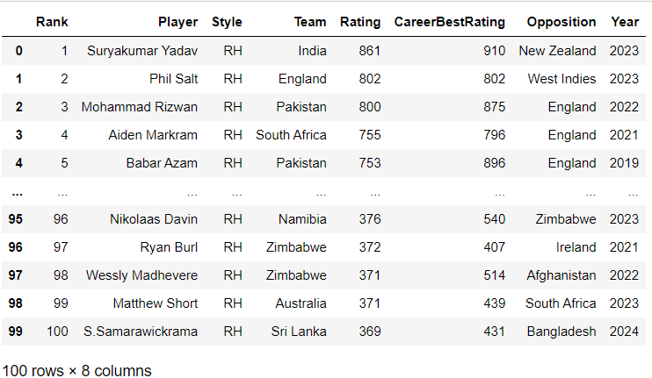
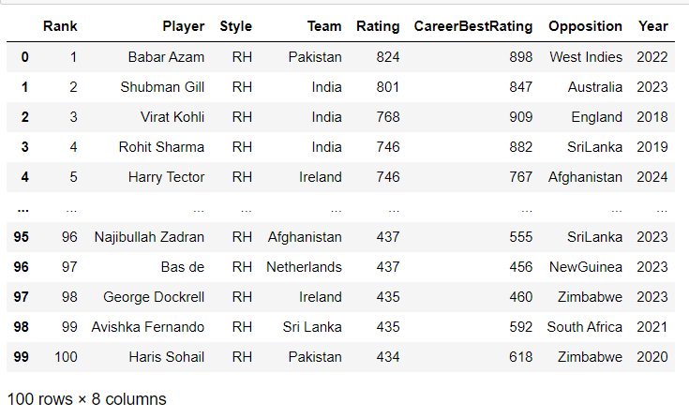
Exploratory Data Analysis(EDA)
Data obtained after scrapping:
Web scrapping is done using Beautiful Soup library in which data is pulled out of HTML code.
T20_Batsman Rankings in df Dataframe
ODI Batsman Rankings in df1 DataFrame

Slide 12
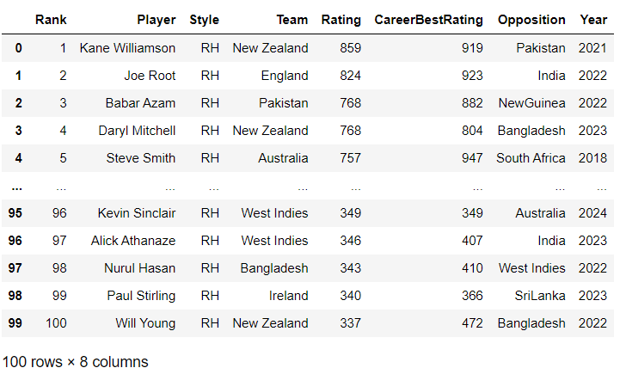
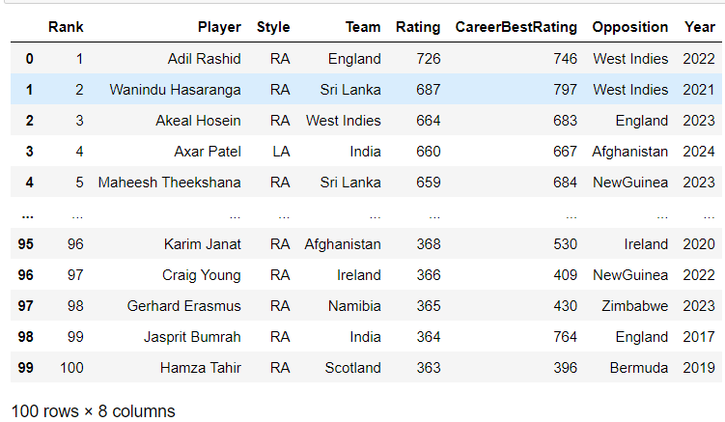
Exploratory Data Analysis
Test Batsman_Rankings in df2 Dataframe
T20_Bowlers Rankings in df3 Dataframe

Slide 13
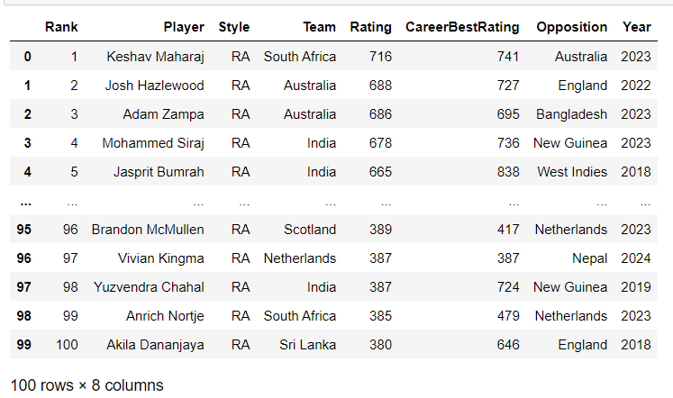
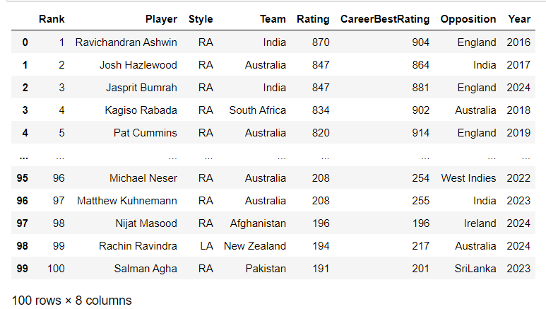
Exploratory Data Analysis
ODI Bowlers Rankings in_df4 Dataframe
Test Bowlers Rankings in df5 Dataframe

Slide 14
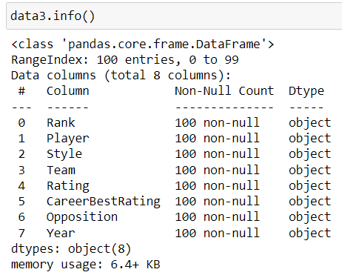
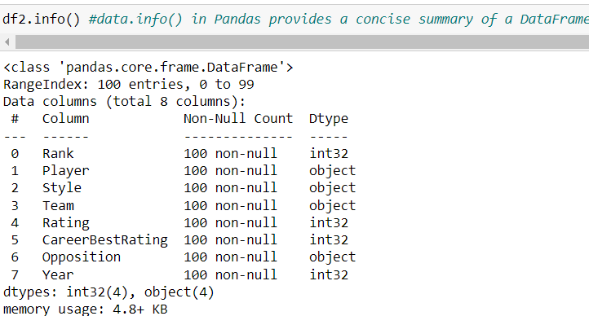
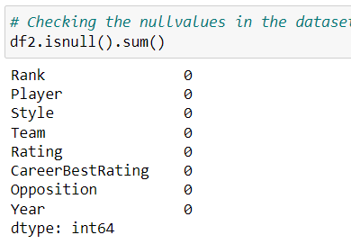
Exploratory Data Analysis
Data Cleaning:
Data cleaning is the process of fixing or removing incorrect, corrupted, incorrectly formatted, duplicate, or incomplete data within a dataset.

Slide 15
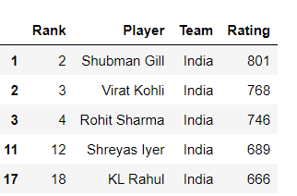
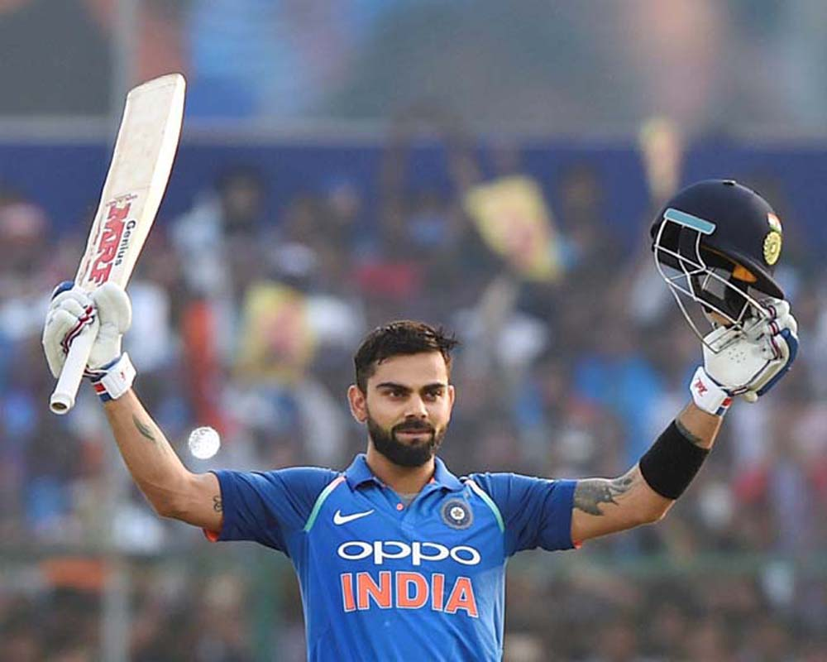
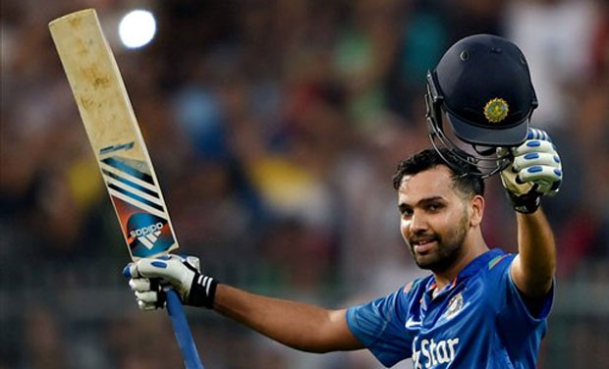
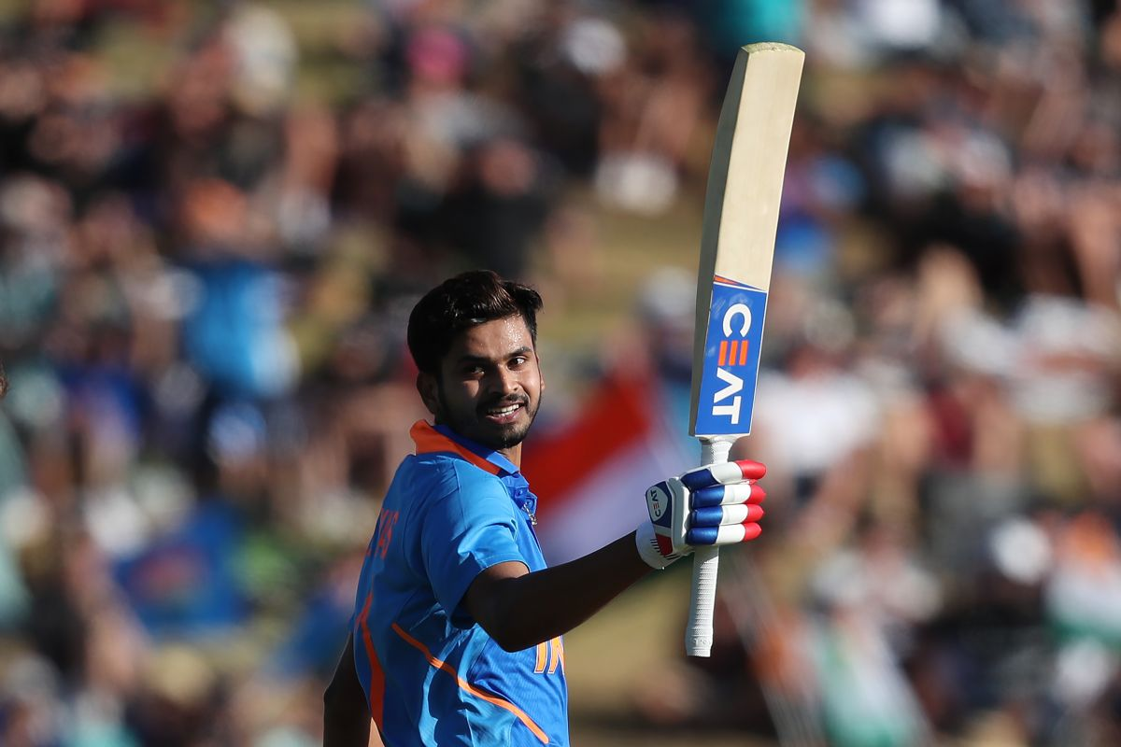
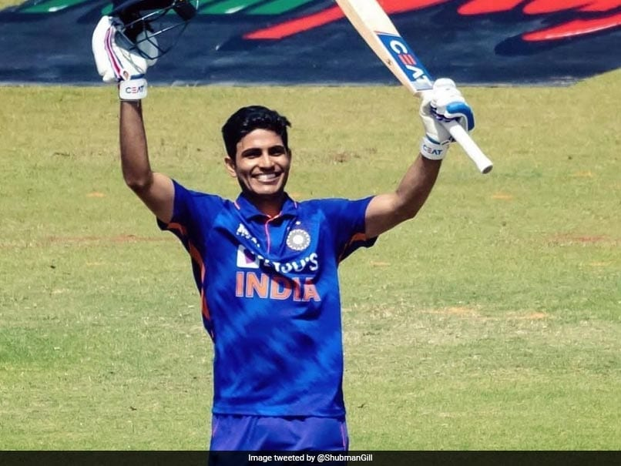
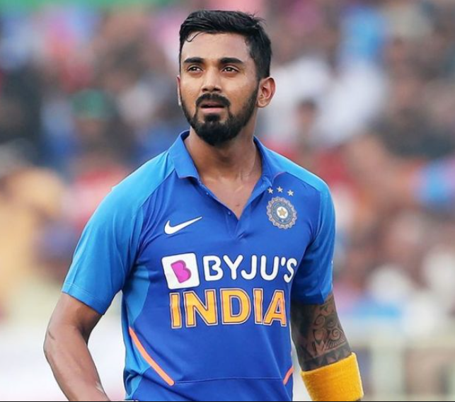
Indian Players involved in Rankings below 20 with Ratings above 600
in ODI Rankings
Rohit Sharma
Virat kohli
Shreyas Iyer
Shubman Gill
KL Rahul

Slide 16
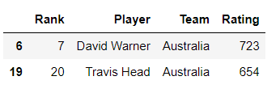
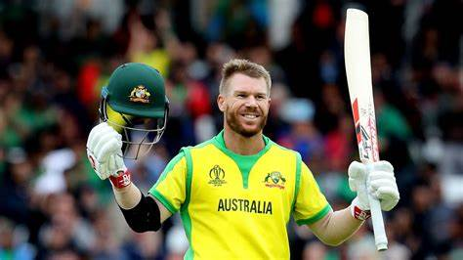
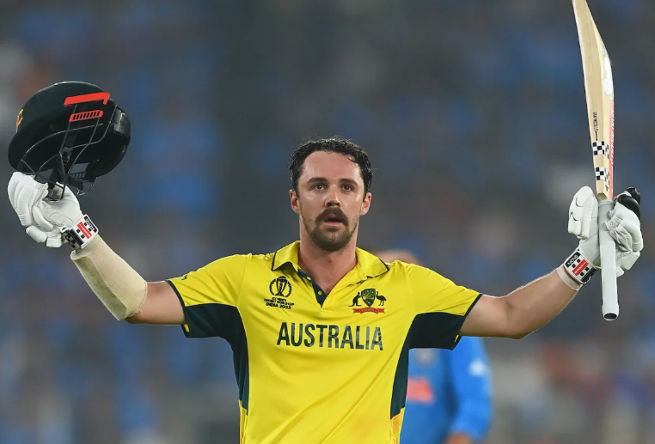
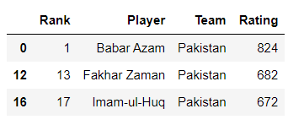
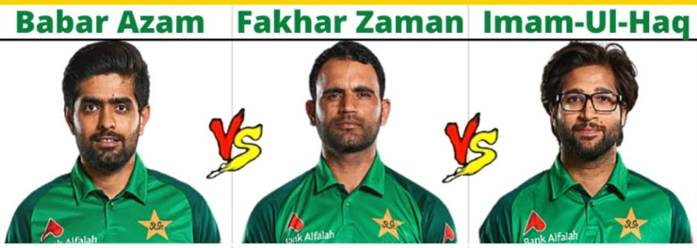
Australia and Pakistan Players involved in Rankings below 20 with
Ratings above 600 in ODI Rankings in ODI
David Warner
Travis Head

Slide 17
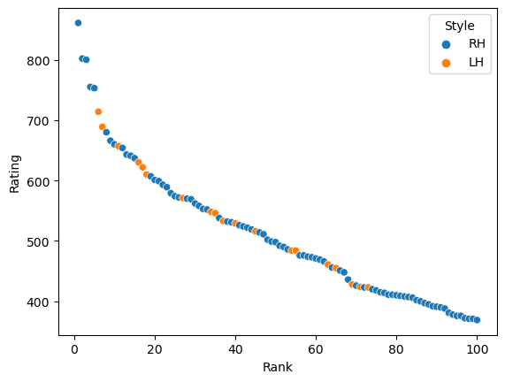
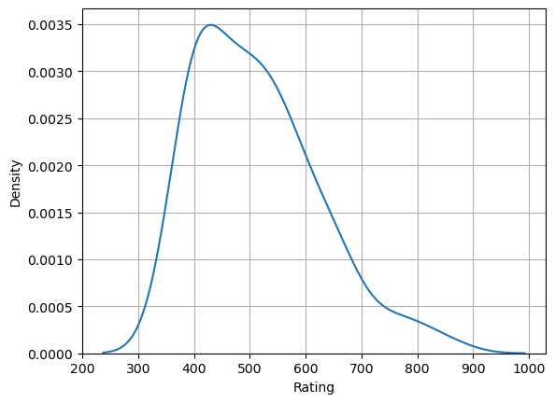
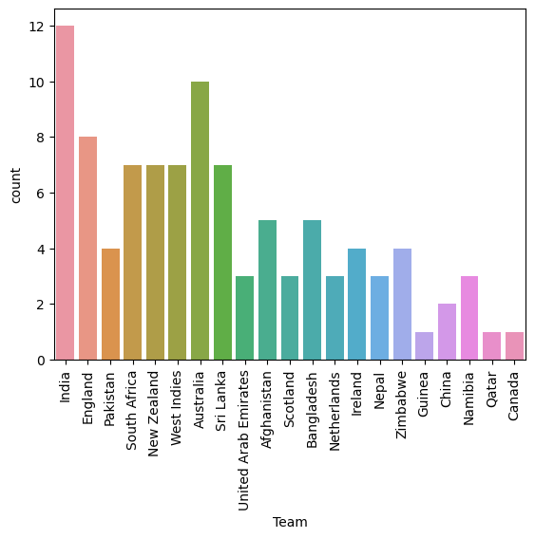
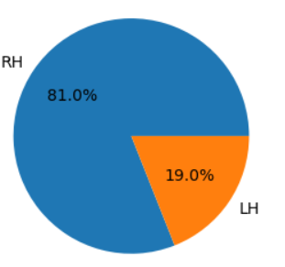
Data Visualization
Data Visualization is the presentation of data in graphical format
.
The importance of data visualization is simple: it helps people see, interact with, and better understand data. Whether simple or complex, the right visualization can bring everyone on the same page, regardless of their level of expertise.

Slide 18
To find the Density of Rating in T20 Rankings
we are using Kdeplot.
Kdeplot shows the density of data.
From the Kdeplot we can infer the
following
Players rating is high in between 400 to 480,
the density is high.
Players rating is less greater than 800 and less
than 300.
fig: Kdeplot

Slide 19
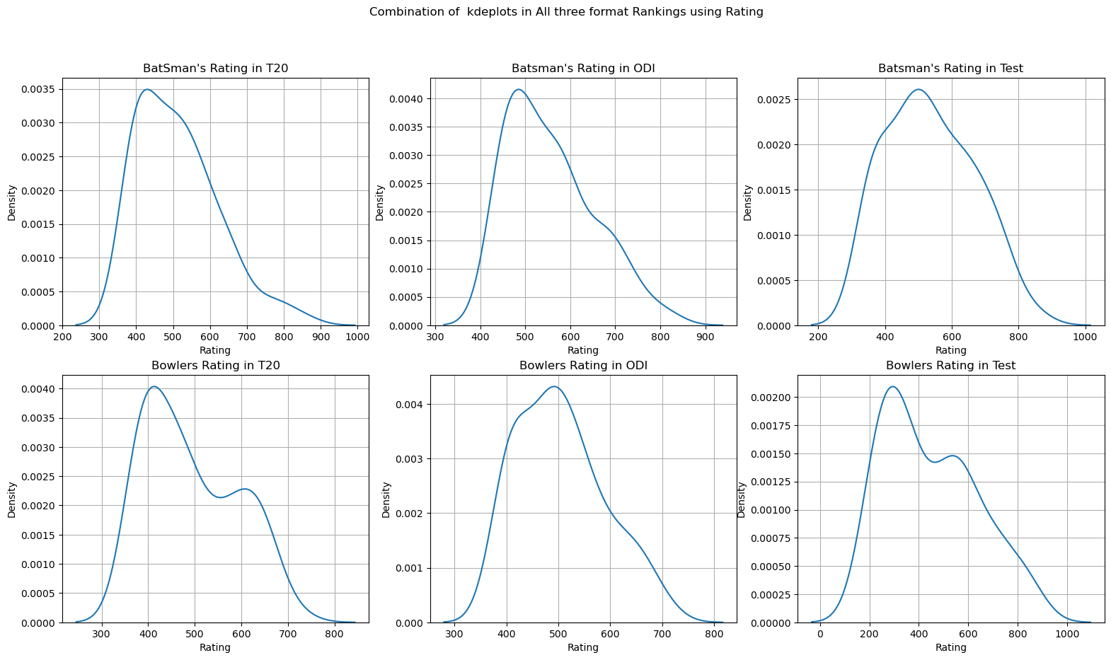
To find the density of Rating in All three format_Rankings
we are using Kdeplot.
fig: Kdeplot in different formats of Cricket.

Slide 20
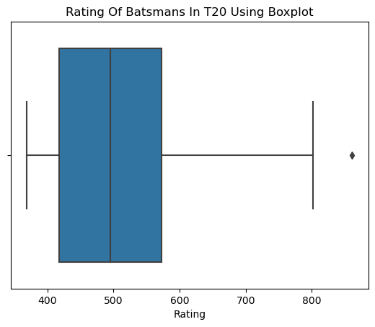
To find the Outliers and Statistical measures of Rating column in data
we are using boxplot.
From the boxplot we can infer the following
75% of players rating is above 420 and in between 25-50%,
50% of players rating is above 520 and 25% of players rating is
above 580.
There are more players with rating in between 420 to 500.
There is only 1 outlier in the Rating Series.
Statistical Measures:
1.Minimum(LB) -184.375
2.First Quartile(Q1) - 417.25
3.Median(Second Quartile(Q2)) - 495.0
4.Third Quartile(Q3) - 572.50
5.Maximum(UP) - 805.375
6.IQR(Q3-Q1) - 155.25
fig: Boxplot

Slide 21
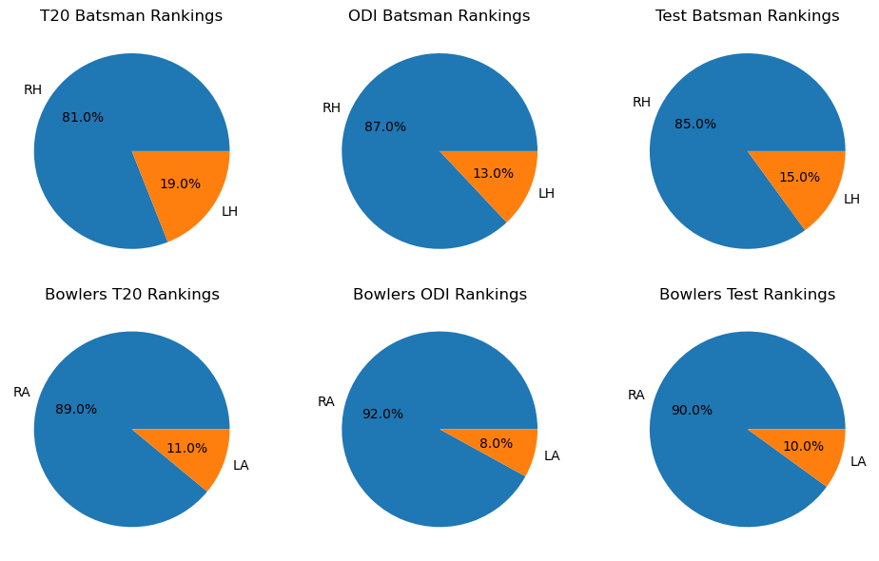
To find the how many Players are LH,RH batsmans and LA,RA bowlers
in All three formats we are using Piechart.
fig: Piechart for LH,RH Batsmans and LA,RA Bowlers
in different formats of Cricket

Slide 22
To find which Team players are more in T20 Rankings
we are using Countplot
From the Countplot we can infer the following
In all three format Rankings more number of players
belongs to India compared to other teams.
Less number of players belongs to Canada, Qatar
and Guinea.
fig: Countplot for different teams in T20 Rankings.

Slide 23
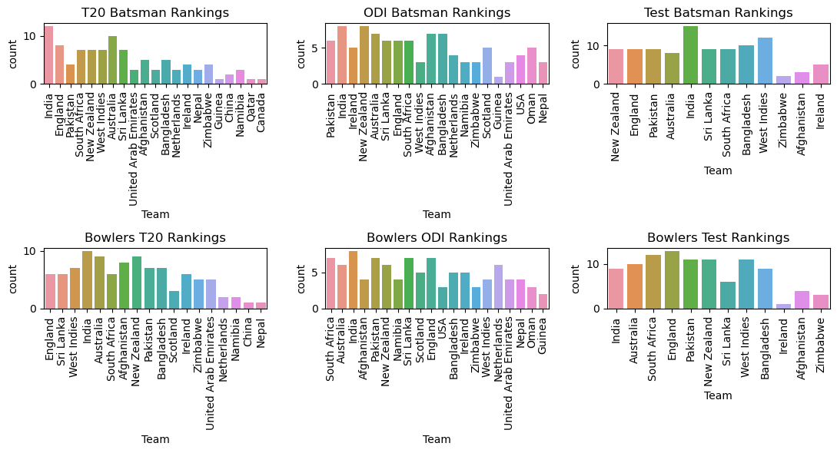
To find which Team players are more in All Three formats
we are using Countplot
fig: Countplot for different teams in All three formats of Cricket.

Slide 24
To know the relationship how Rank and Rating are related in
T20 Rankings we are using Scatterplot..
From the barplot we can infer the following
Shows the correlation between rank and rating
in T20 Rankings
As the rank increases the rating is decreasing.So,they are negetively
correlated.
Finally we can say that the players with below 20 ranks has more ratings
compared to above 60.
RH Style Batsmans are more compared to LH Style Batsmans.
fig: Scatterplot

Slide 25
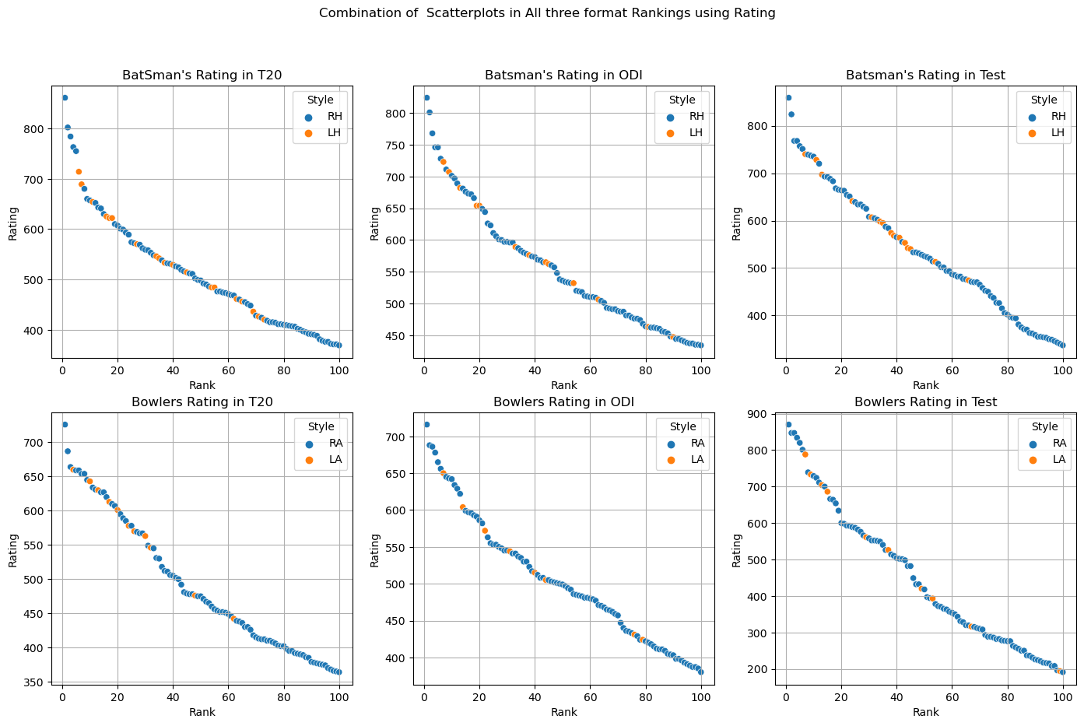
To know the Relationship how Rank and Ratings are related in
All three formats we are using Scatterplot..
fig: Scatterplot in different formats of Cricket .

Slide 26
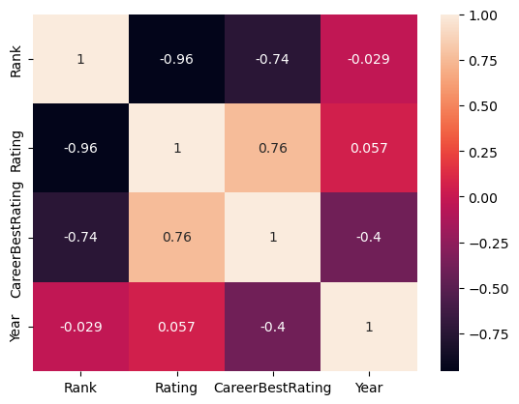
To find the correlation between two or more entites(variables)
we are using heatmap.
From the Heatmap we can infer the following
Rank and CareerBestRating are negetively correlated means as Rank is increasing
CareerBestRating of players is decreasing,
Rank and Rating are negetively correlated means as Rank is increasing
Rating of players is decreasing,
Rating and CareerBestRating are positively correlated means as Rating is increasing CareerBestRating of players also increasing.
fig: Heatmap

Slide 27
Observations
From the above analysis we can infer that players below rank 20 have high rating compared to others.So,we can say that as the rank is increasing the rating of batsmans and bowlers is falling down,
To be in Top 10 rankings the player should maintain stability on rating by scoring runs.
From the above analysis we can infer that there are more players in indian team in all formats of cricket compared to other teams.
There are more RH,RA style batsmans and bowlers in Rankings compared to LH,LA style batsmans and bowlers.
From the above analysis we can infer that players rating is more in between 400 to 600 and less above 850.
Therefore we can predict that in between 400 to 600 we can see more players ratings.

Slide 28
Conclusion
The project aim is to analyze the rankings and ratings in all three formats of cricket
From above analysis we can conclude that if more players are involved in rankings then
there team popularity increases and that team will be in good position in ICC Cricket Rankings
We can also predict if the players maintains a Average rating above 600 there will high chances to be in - Top 10 Rankings in all three formats of cricket.
This way we can analyse the areas of improvement of players to have better ranks and rating in
all three formats of cricket.

Slide 29

THANK YOU

